Slide 1
Microsoft Power BI

Slide 2
Developing with the Power BI Quick Create SDK
Amanda Rivera
Principal Program Manager
Power BI Team
Ted Pattison
Principal Program Manager
Power BI Customer Advisory Team (PBICAT)

Slide 3
Agenda
Overview of the Power BI QuickCreate Experience
Dynamics 365 QuickCreate Demo Walkthrough
Developing with the QuickCreate SDK
Developer Demo Walkthrough
Developer Roadmap

Slide 4
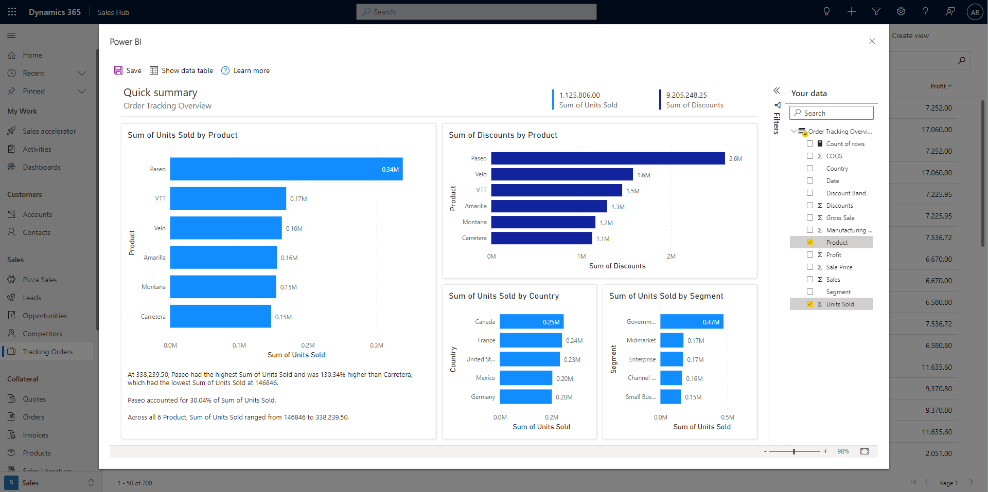
Mission
Provide a simple developer experience for anyone who wants to offer automatic and interactive data analytics to their users.

Slide 5
Benefits to End Users
With one click users land on an automatically generated, interactive report based on their data
Reports are easy to customize, so users can focus on the data that’s most interesting to them
Reports can be saved to the end users workspace, where they can be further customized or even downloaded to Power BI Desktop to modify the query and model
The entire experience only requires end users to sign up for a free Power BI license

Slide 6
Benefits to Developers
Integrating has no cost to developers – it’s User-Owns-Data embedding
You don’t have to spend time pre-building template reports to meet your end users' diverse needs

Slide 7
Dynamics 365 Demo
Demo Time

Slide 8
Agenda
Overview of the Power BI QuickCreate Experience
Dynamics 365 QuickCreate Demo Walkthrough
Developing with the QuickCreate SDK
Developer Demo Walkthrough
Developer Roadmap

Slide 9
Developing with the QuickCreate SDK
QuickCreate SDK is new addition to Power BI JavaScript API
Support added to JavaScript library used for Power BI embedding (powerbi.js)
Can be programmed using JavaScript or TypeScript
QuickCreate SDK supports User-Owns-Data embedding
No current support for App-Owns-Data
User must be licensed and have create permissions in target workspace

Slide 10
Quick Create Supports User-Owns-Data Embedding
Developer must create Azure AD application
Application can authenticate user as SPA using client-side code in browser
Application can authenticate user with server-side code with authorization grant flow
Application must acquire Azure AD access token for current user
Use a Microsoft authentication library such as msal-browser.js
User permissions: Content.Create, Dataset.ReadWrite.All, Report.Read.All & Workspace.Read.All

Slide 11
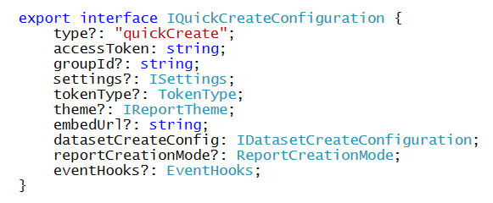
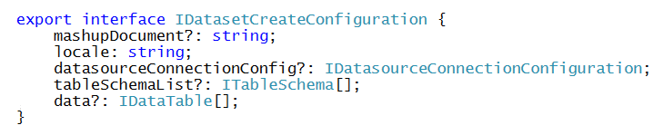



IQuickCreateConfiguration
QuickCreate programming based on IQuickCreateConfiguration
You define the type of dataset to create using IDatasetCreateConfiguration
You can pass a schema and data for dataset using IDataTable

Slide 12
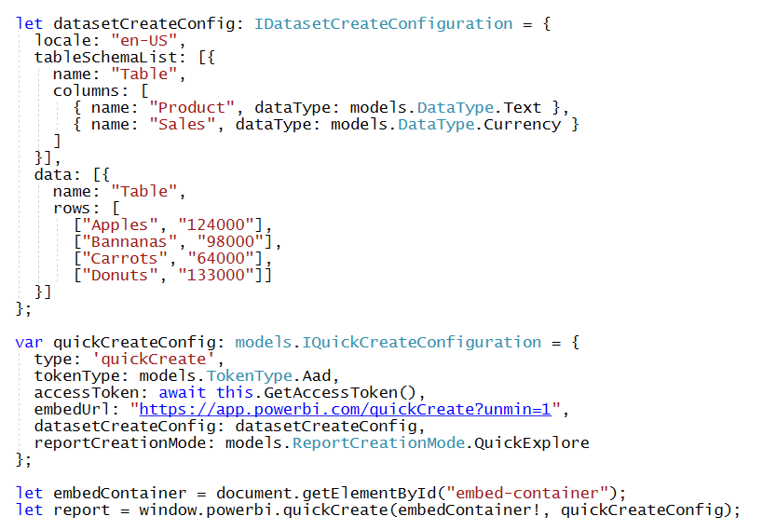
Create a dataset without a data source

Slide 13
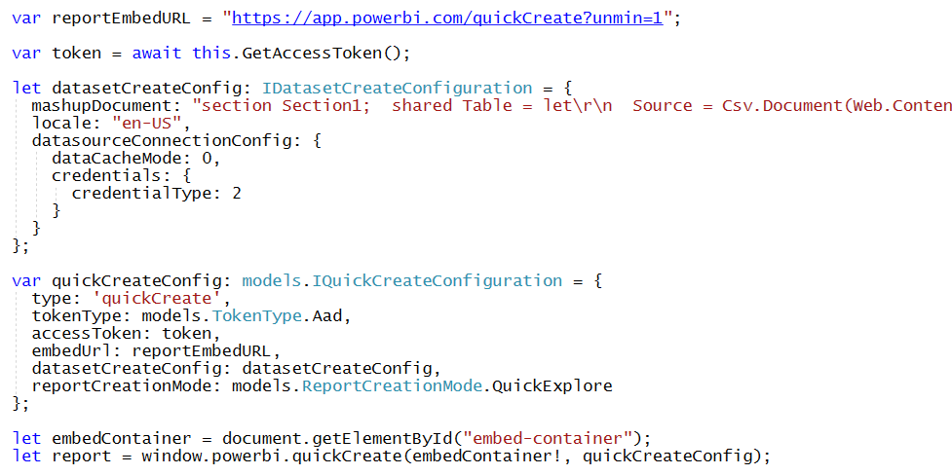
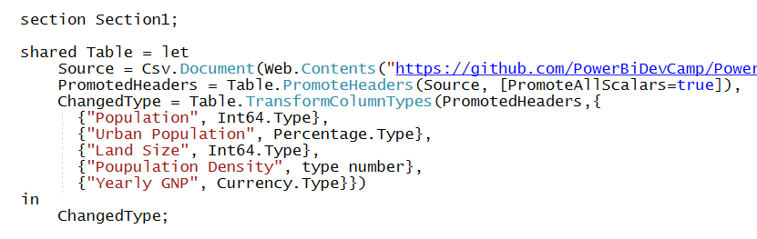
Create a dataset using Power Query M code
M Code to query datasource

Slide 14
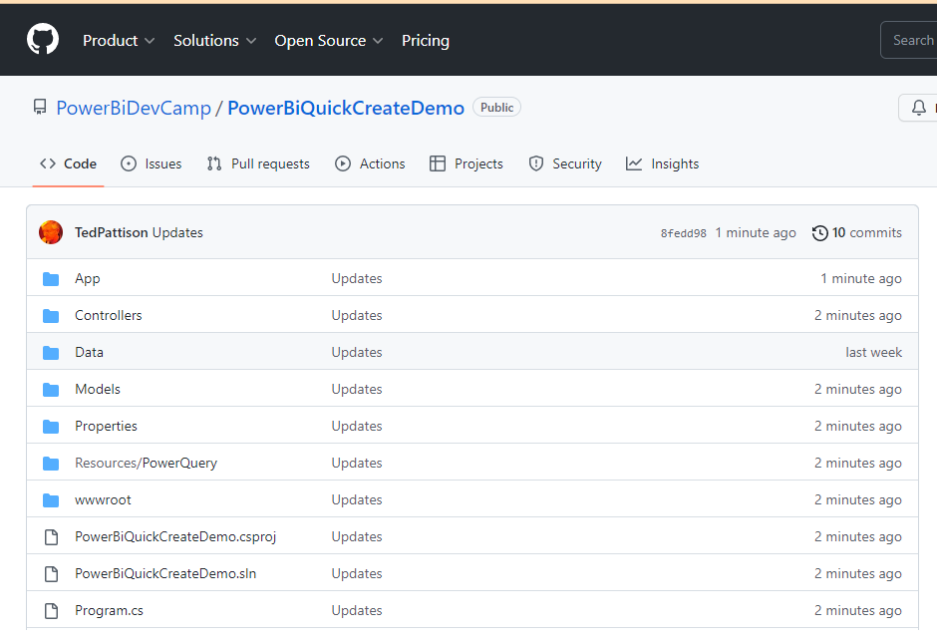
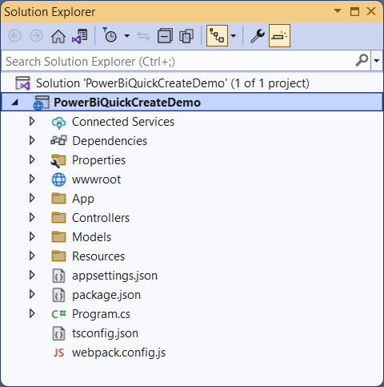
GitHub Repo with PowerBiQuickCreateDemo
https://github.com/PowerBiDevCamp/PowerBiQuickCreateDemo

Slide 15
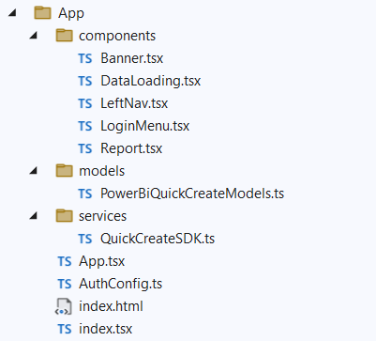
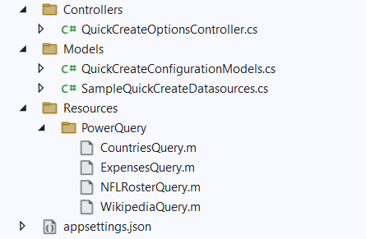
PowerBiQuickCreateDemo
PowerBiQuickCreateDemo
Can be opened and tested in any edition of Visual Studio 2022
Client SPA created using React, TypeScript and Webpack
Web API backend created using .NET 6 and ASP.NET Web API support

Slide 16
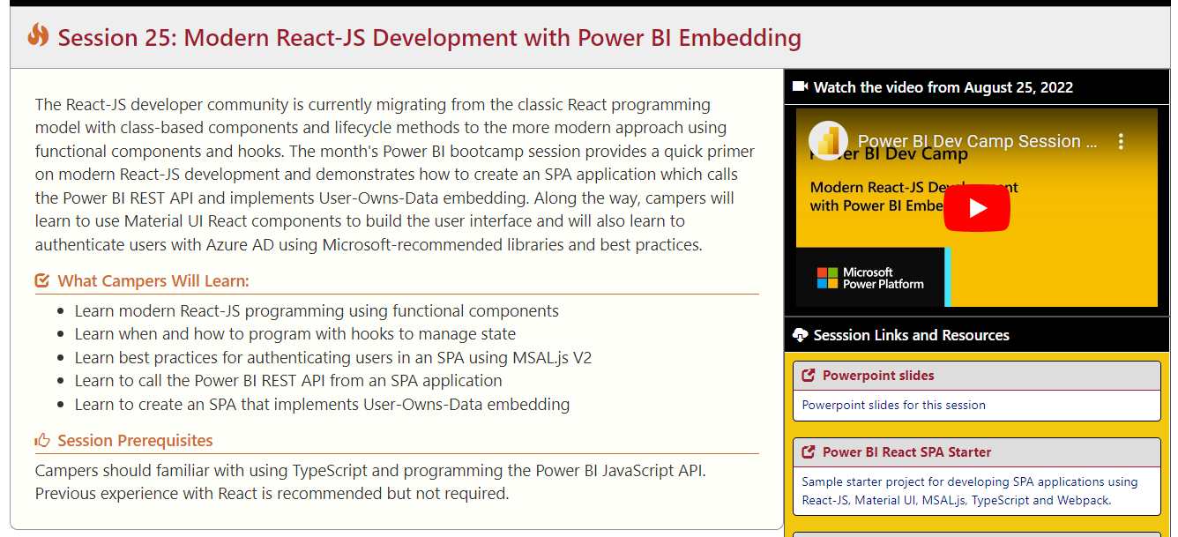
Need To Learn About React and SPA Authentication?
Dev Camp Portal Page: https://www.powerbidevcamp.net/sessions/session25
Youtube Video: https://youtu.be/3xpi7youCNI

Slide 17
Developing with the QuickCreate SDK
Demo Time

Slide 18
Developer Roadmap
Near term incremental improvements
Setting default aggregations for fields
Performance improvements
Long term
Support for data sources with authentication
Multi-table model support

Slide 19
Resources & Links
Embed a Quick Report https://learn.microsoft.com/en-us/javascript/api/overview/powerbi/embed-quick-report
QuickCreate Class https://learn.microsoft.com/en-us/javascript/api/powerbi/powerbi-client/quickcreate.quickcreate
QuickCreate Configuration https://learn.microsoft.com/en-us/javascript/api/powerbi/powerbi-models/iquickcreateconfiguration

Slide 20
Microsoft Power BI
Questions?

